Slide 1
SHINE
Presentation
Angat National High School
Taboc, Angat, Bulacan

Slide 2
The Program Description…
This SHINE program is initiated by the
Provincial Government of Bulacan thru the
Provincial Disaster Management Office (PDMO)‏
That aims to have full awareness of the different
Weather conditions in the place as a concern for
The environment especially now that the country
Is experiencing different climate changes.

Slide 3
The school as one of the active participants
Of the program has its share of transferring
pertinent data to the office of the PDMO as well
as to PAGASA to monitor the conditions
especially during rainy season and extreme weather events.
The group will have daily observations to
the installed rain gauge about the daily weather
condition.

Slide 4
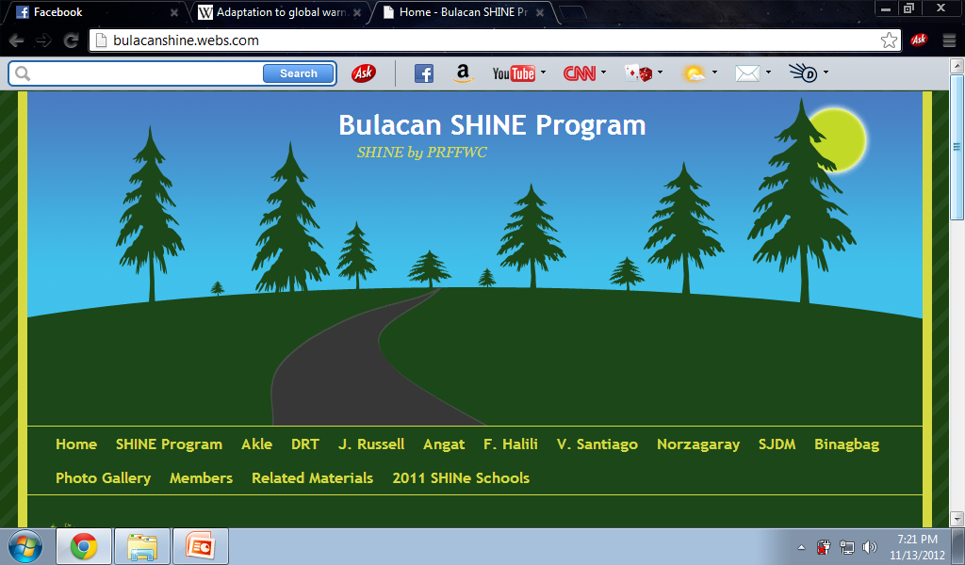

Slide 5
The Working Group…
Student Leader
Rainfall Observers
Info Board Group
Green Team
Water Level Observers
Grade 7 Members
Second Year Members
Third Year Members
Fourth Year Members
Data Encoders
Lead Teacher and Group Leaders

Slide 6
Benefits of SHINE Program:
To the school;
Students will know the amount of rainfall during rainy season.
Students will gain knowledge on how to track a typhoon.
Students become responsible enough and vigilant on what is happening in their environment.

Slide 7
Students will now have the capacity to inform other people especially their relatives regarding on what they have learned during the SHINe seminar
(b) To the community;
serves as an awareness during rainy season to prepare themselves in time of calamity

Slide 8
The
READINGS

Slide 9
FEBRUARY

Slide 10
MARCH

Slide 11
April

Slide 12
May

Slide 13
June

Slide 14
july

Slide 15
august

Slide 16
september

Slide 17
october

Slide 18
November

Slide 20
Plans…

Slide 21
The group will make more improvised rain gauge not only in the school but in the house of each member to have more comparisons about the weather conditions.
More active members will be recruited and trained in taking observations.

Slide 22
Science group will be encouraged to be more participative in the program.
SHINE club and it’s members aims to expand the knowledge they have regarding the program to the community by means of conducting a seminar.

Slide 23
SHINE club together with the
YES-O club aims to promote more environmental activities.
(tree-planting.. Etc.)
Dissemination of information to the community to the use of leaflets.

Slide 24
Climate Change
Adaptation

Slide 25
- The response to climate change that seeks the vulnerability of biological systems.

Slide 26
- How are we able to survive?
-Enhancing our adaptive capacity.
-Weather control.
-Promoting and being an active participants of a Clean and Green Campaign.

Slide 28
Thank You!!!

