Slide 1



SHINe PRESENTATION
VEDASTO R. SANTIAGO HIGH SCHOOL

Slide 2

SHINe’s
Main Objective…
To enhance disaster awareness of the school populace; prevent loss of life and protect property by achieving and maintaining a high-level of school preparedness.
To work hand-in-hand with the LGU’s Disaster Coordinating Council, particularly with their CBFWS (Community-Based Flood Warning System) or the local flood warning system of the community.
The program is particularly more important to areas that are vulnerable and prone to floods and flashfloods.

Slide 3

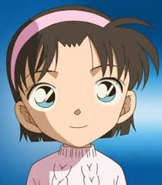
The SHINe Program has the
following objectives…
Monitoring
Warning
Forecasting
and other services…

Slide 4
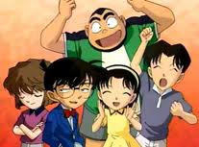
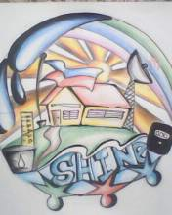

SHINe Officers
President: Archy Valencia
Vice President: Trixie Sarmiento
Secretary: Coleen Alexis del Mundo
Treasurer: Sophia Legasca
Auditor: Sheena Coleene de Guzman
Creative Staff: Angelica Ceralde
Record Keeper: Rachelle Domingo
Representatives:
Grade 7: Mariela Cabuhat
Grade 8: Rc Simbaco
3rd Year: Khya Rose Superior
4th Year: Aileen Mores

Slide 5
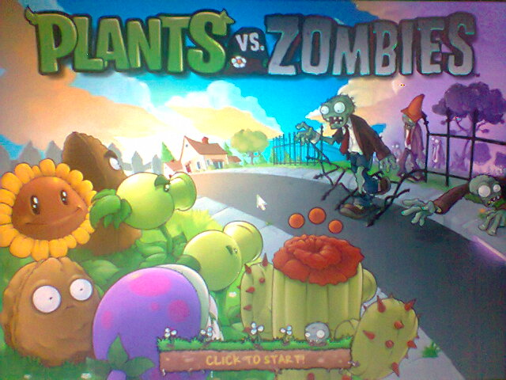
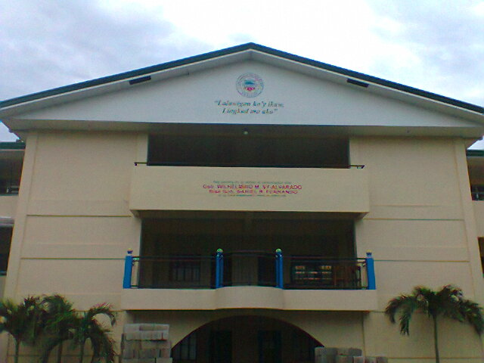
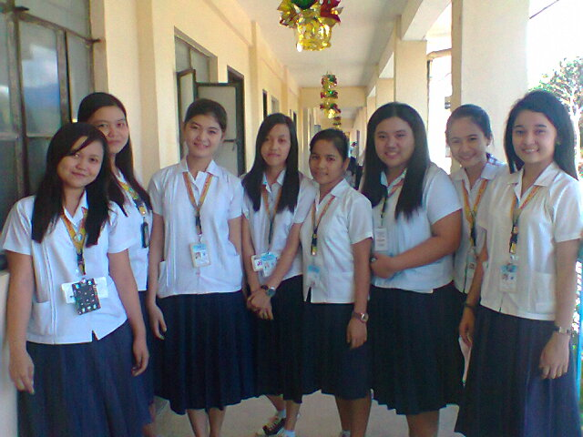
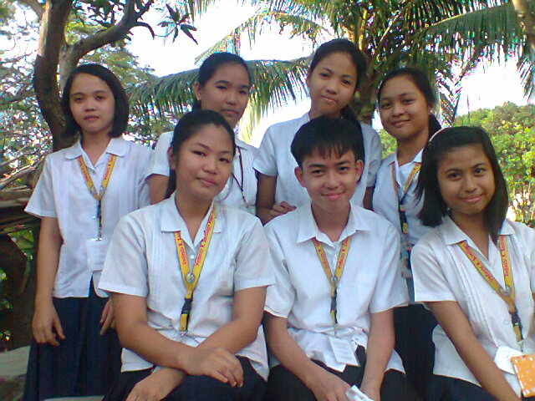
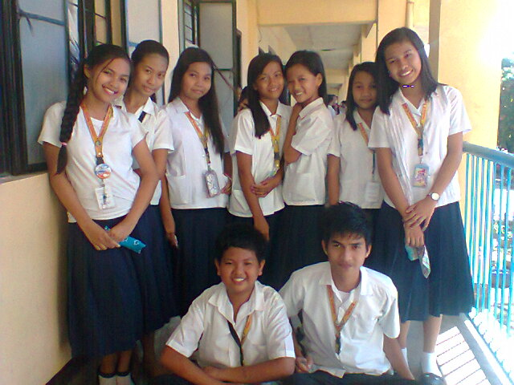
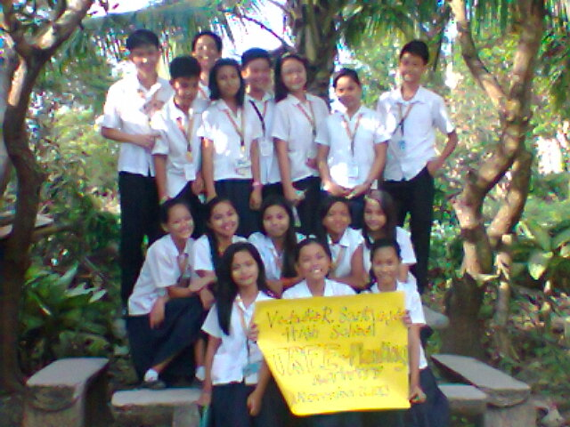
SHINeMEMBERS

Slide 6

GRADE 7 Members
Mariel Cabuhat
Kobe Olsen Gomez
Michael Joseph Gomez
Analiza Silva
Morella Diane Silva
Diane Nicolle Angeles
June Chico
Kyana Rie Zyka Superior
Danica Angel Anib
Irish Nicole Lacanilao

Slide 7
GRADE 8 Members
Sophia Marie Lagacasa
Rc Simbaco
Jazzy Channae Batan
Nhoreyn Maglaque
Hannah Santos
Keyc Silverio
Rachelle Domingo
Jeremy Lazaro
Scott Bryan Sicula
John Eyrald Guttierez

Slide 8
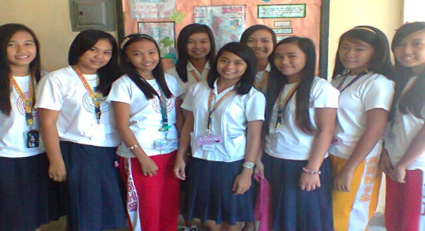
Third Year Members
Angelica Ceralde
Isaac Zoe San Gabriel
Khya Rose Kyla Superior
Jessica Pelayo
Marlyn Magcalas
Noelle Santiago
Edriz Capalad
Cielo Princess Nazar
Reymar Audrey Manalili
Jelyn Gonzales
Krista Maniquiz

Slide 9
Fourth Year Members
Archy Valencia
Sheena Coleene de Guzman
Kimberly Manalili
Trixie Ann Sarmiento
Jhocel Tecson
Jocel Ann San Gabriel
Aileen Mores
Ervin Jay Palomo
Coleen Alexis del Mundo
Meekah Mananghaya
Cassandra Amoranto

Slide 10

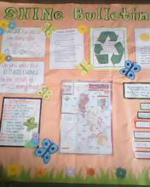
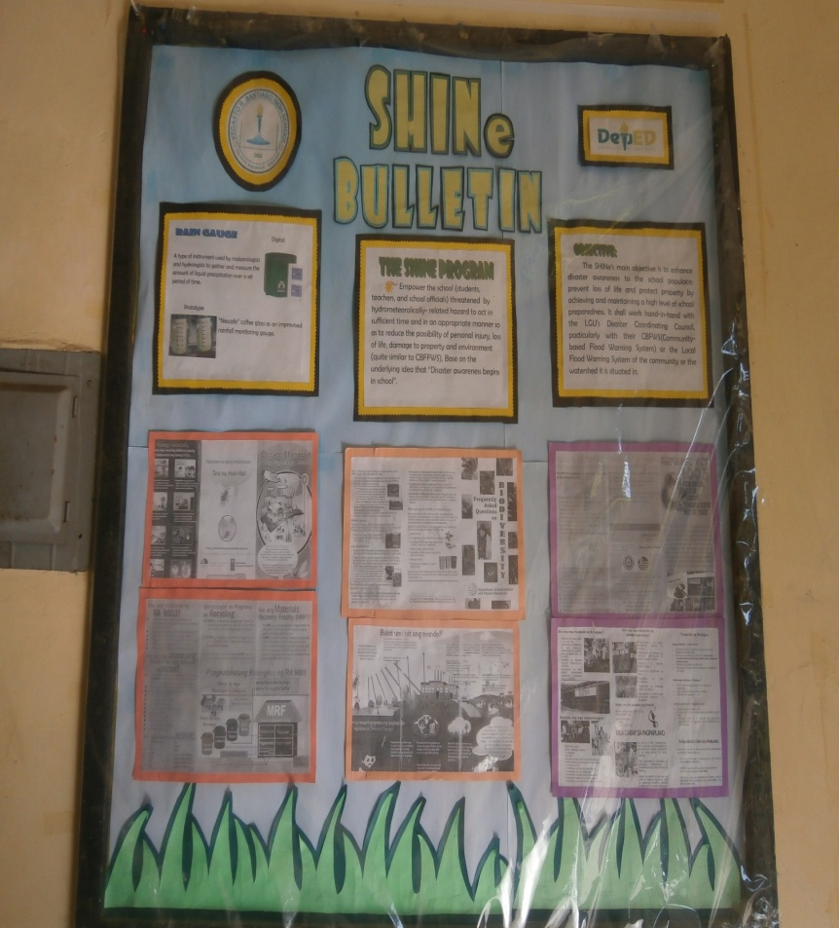
SHINe Bulletin

Slide 11
The SHINe LOGO
By: Angelica Ceralde

Slide 12
Activities of SHINe Club
Tree Planting
Energy Conservation
Garbage Segregation
Prohibition of smoke belching vehicles in school premises

Slide 13
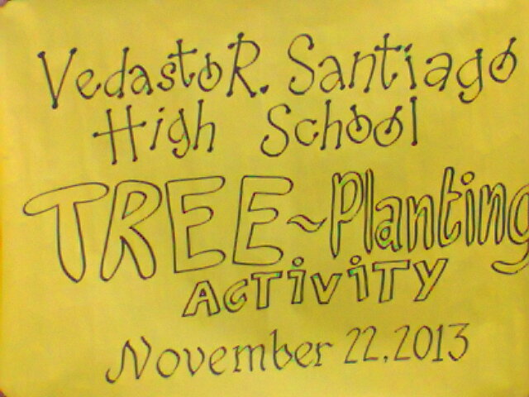
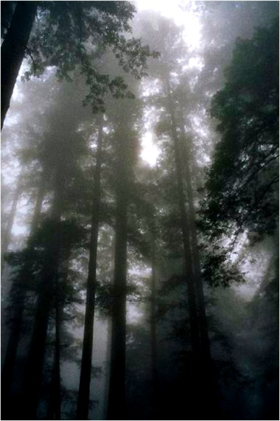
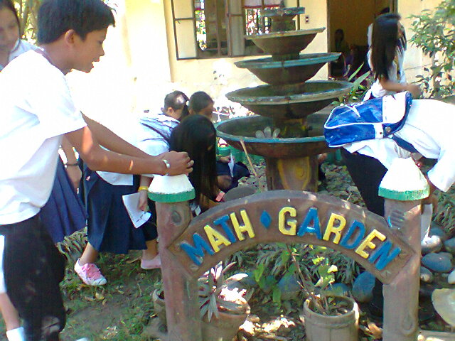
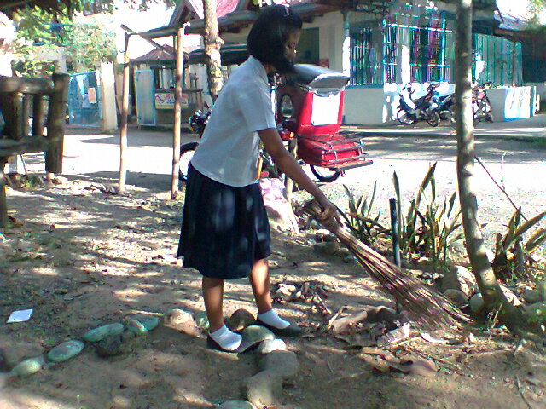
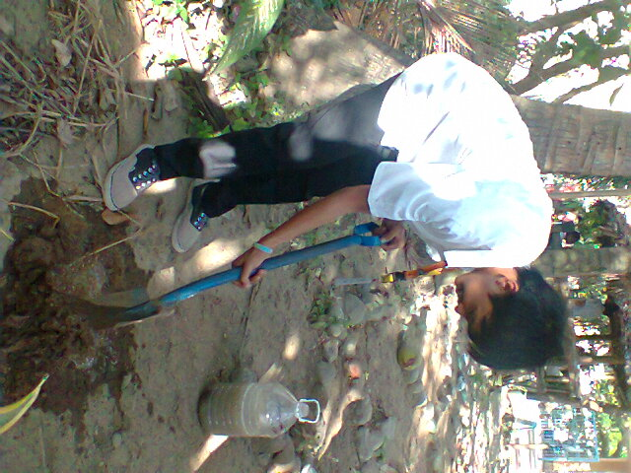
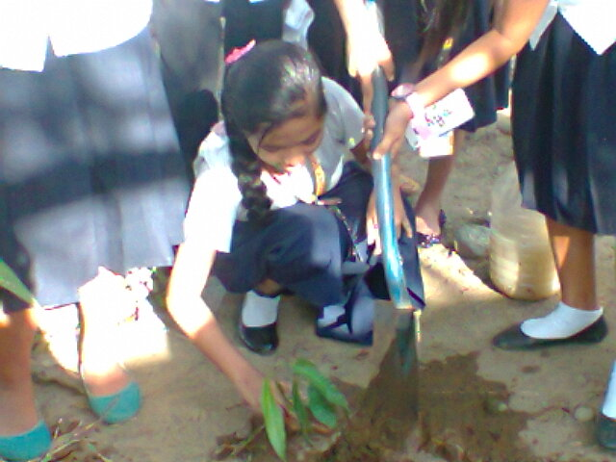
Tree Planting Activities

Slide 14
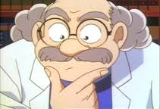
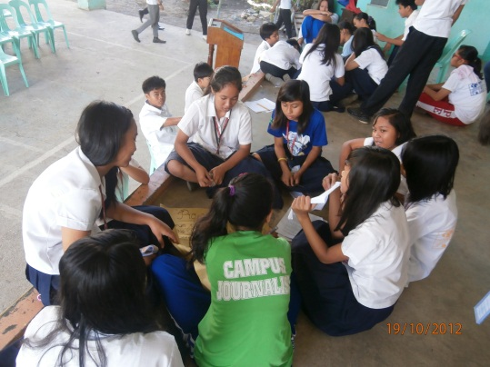
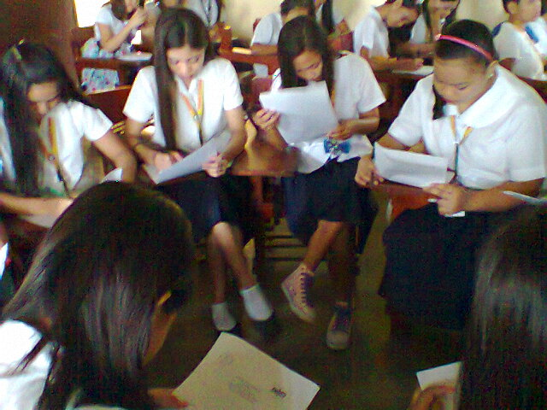
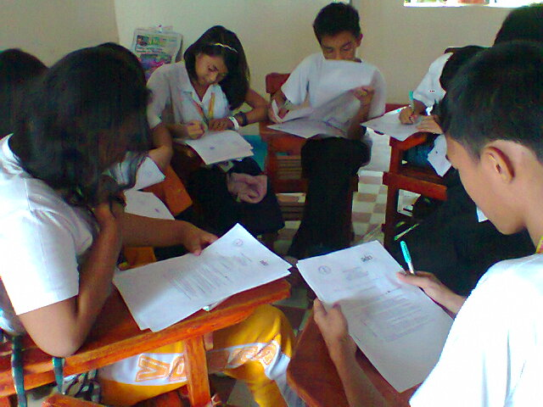
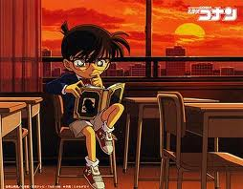
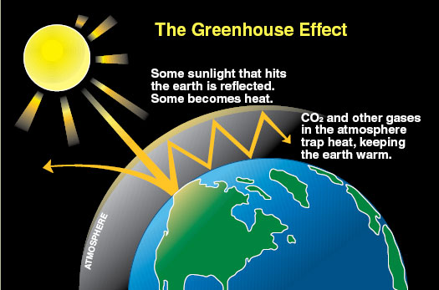
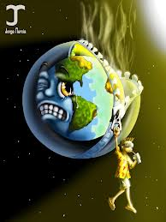
“Sharing of Ideas about the effects of Climate Change…”

Slide 15

“Shared Ideas about the Effects of Climate Change…”
We, students, can do something to save the earth from the disastrous effects of Climate Change. So, here are the simple things we can do…
1. Minimize the use of deodorants, as they contain CFC (Chlorofluorocarbon) that contributes to the ozone depletion, which in turn gives rise to most destructive effects.
2. Forests play an important role in absorbing carbon dioxide, thus reducing the amount of carbon dioxide in the atmosphere.
3. Encourage the use of renewable sources of energy like air, biomass, solar, etc.
4. You can contribute recyclable things like aluminum cans, newspapers, card-boards, recyclable plastic, glass or anything to the recycling center near you.
5. Let’s decrease the amount of waste.
6. Switch off the lights, fans and air conditioners when not in use.
7. Raise awareness! Educate people about global warming and its disastrous effects.
8. The most important of all, let us all vow to plant and nurture it. A single tree can absorb amazing amounts of carbon dioxide over its lifetime. Let us all contribute to making this world a better place to live in.

Slide 16
PROJECT PROPOSALS
Transformation of garbage into a useful materials
    Plastic wrappers into bayong
    Use self made notebooks
    Contest for the Best Rags to Riches material transformation
Fund Raising
    Docu – showing

Slide 17
To make the “Material Recovery Facility” be possible
To help save “Biodiversity”
Each of us can contribute to the preservation of our biodiversity by doing the simplest activities in everyday life:
  Planting trees
  Participating in river rehabilitation projects
  Not disposing garbage in our water bodies to avoid clogging our waterways
  Saving energy, paper and fuel
  Boycotting wildlife products such as fur, tusk, and hooves
  Turning off lights
  recycling and stopping the use of plastic bags

Slide 18
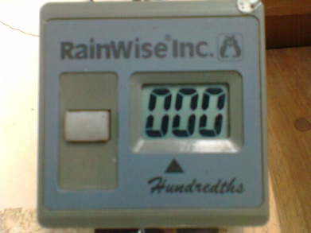
PRESENTATION OF DATA
2013

Slide 19
January 2013

Slide 20
February 2013

Slide 21
March 2013

Slide 22
April 2013

Slide 23
May 2013

Slide 24
June 2013

Slide 25
July 2013

Slide 26
August 2013

Slide 27
September 2013

Slide 28
October 2013

Slide 29
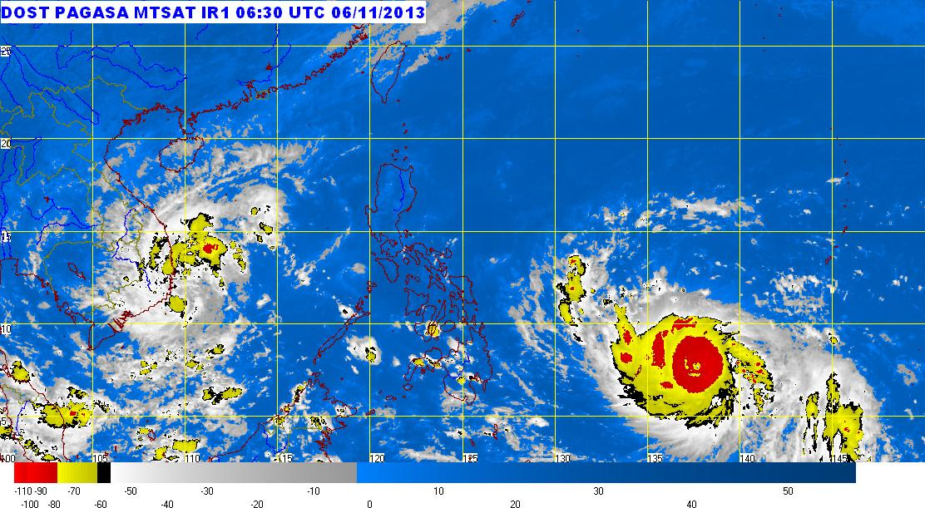

TYPHOONS
January-November

Slide 30
JANUARY
-AURING
-BISING
FEBRUARY
-CRISING

Slide 31
MARCH
None
APRIL
None
MAY
None

Slide 32
JUNE
-DANTE
-EMONG
-FABIAN
-GORIO

Slide 33
JULY
-JUANING
-ISANG
-JOLINA

Slide 34
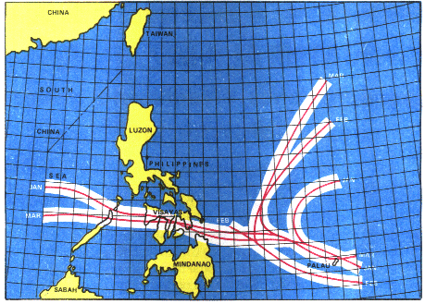
AUGUST
KIKO
NANDO
LABUYO
MARING

Slide 35
SEPTEMBER
ODETTE
PAULO
QUEBEN

Slide 36
OCTOBER
RAMIL
SANTI
TINO
URDUJA
VINTA

Slide 37
NOVEMBER
WILMA
YOLANDA
ZORAIDA

Slide 38
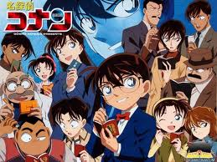
Thank You for listening!!!
“Take care of Nature and it will take care of You…”

