Slide 1
Sta. Lucia High School
Presents…

Slide 2
Rain Gauge...

Slide 3
Steps:
Get the pipe inside the rain gauge
Use a meter stick in measuring the total amount of water inside the pipe
Use millimeter as its measurement
Then , record it in the monthly data sheet.

Slide 4
].

Slide 5
2.

Slide 6
3.

Slide 7
4.

Slide 8
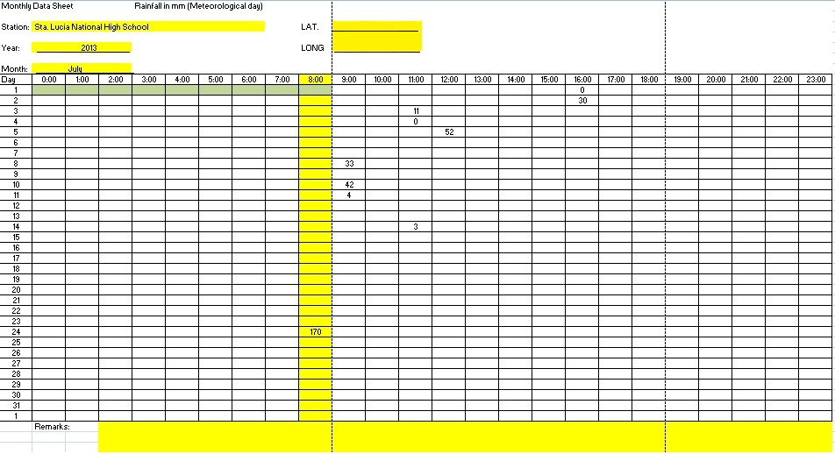

Slide 9
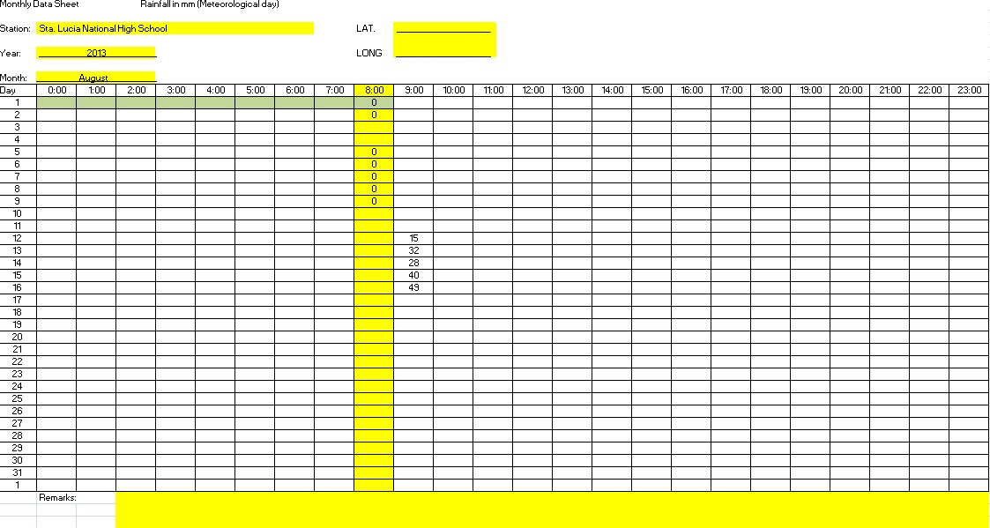

Slide 10
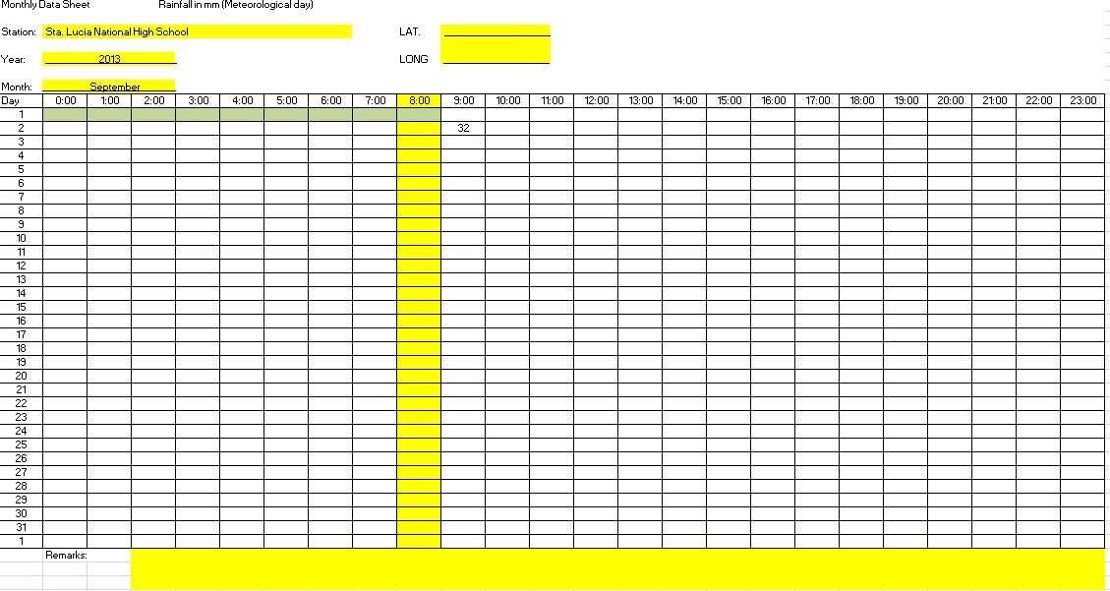

Slide 11
Our apology for the days without measurements…

Slide 12
Thank You for listening ☺☺☺
-D.R.E.A.M Team☺

Slide 13
Sta. Lucia High School
Presents…

Slide 14
D.R.E.A.M Team
D.R.E.A.M Team
D.R.E.A.M Team
D.R.E.A.M Team
D.R.E.A.M Team
D.R.E.A.M Team
D.R.E.A.M Team
D.R.E.A.M Team
D.R.E.A.M Team
D.R.E.A.M Team
D.R.E.A.M Team
D.R.E.A.M Team
D.R.E.A.M Team
D.R.E.A.M Team
D.R.E.A.M Team

Slide 15
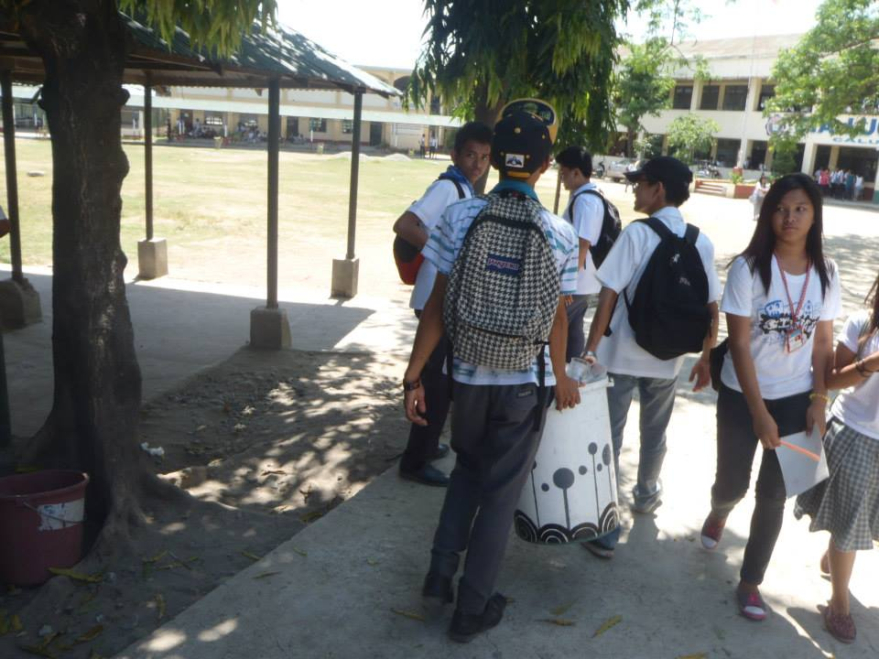

Slide 16
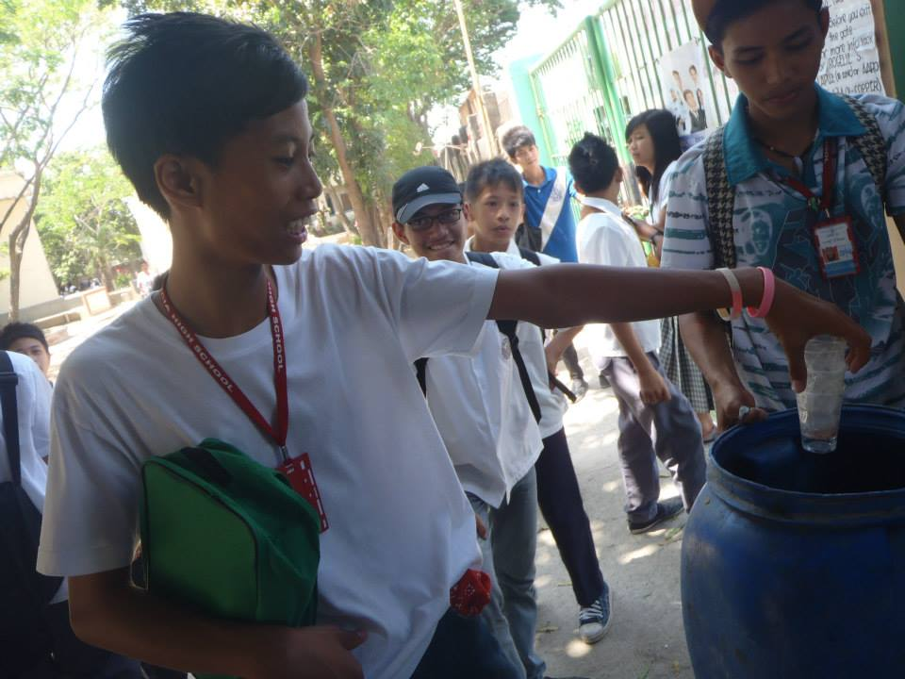

Slide 17
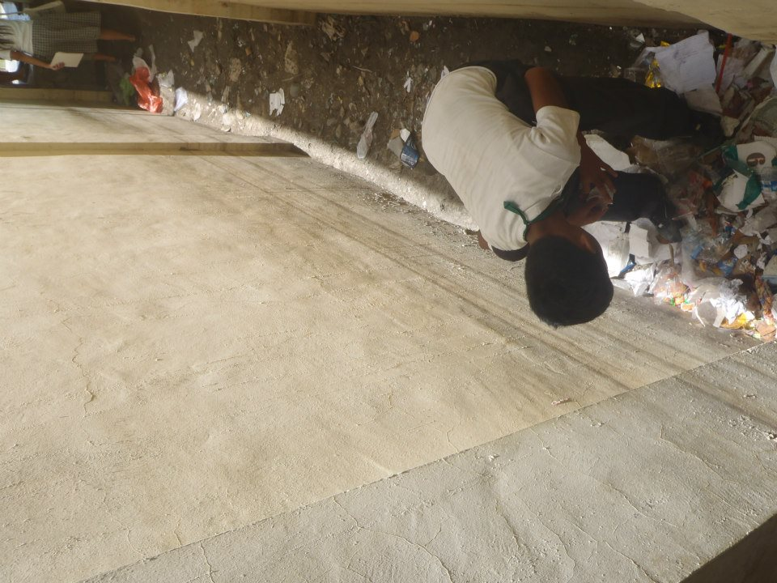

Slide 18
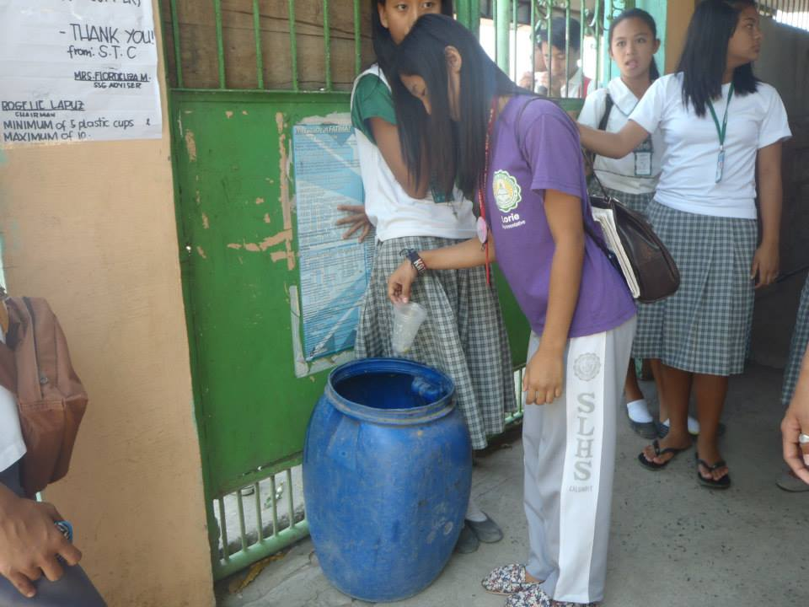

Slide 19
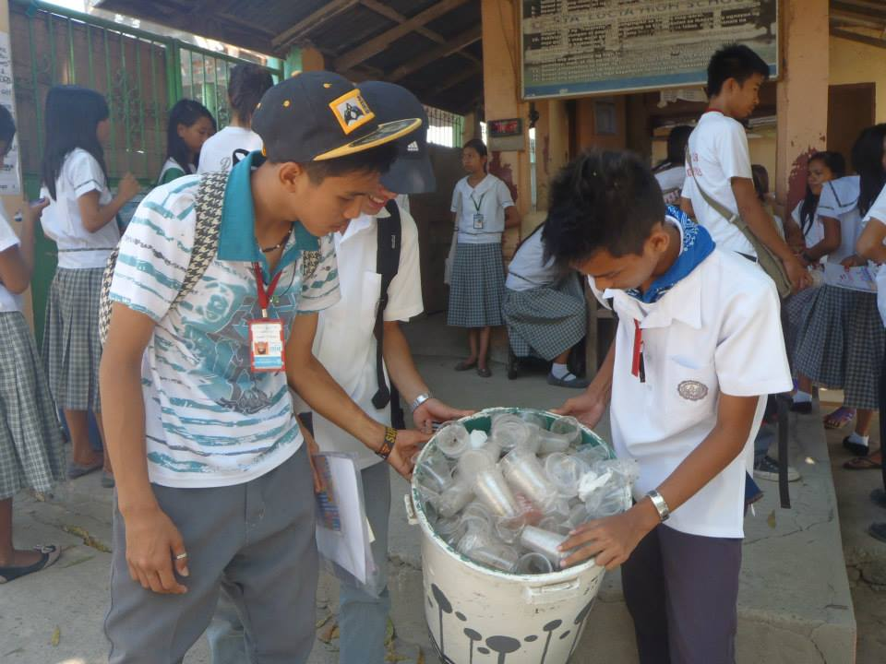

Slide 20
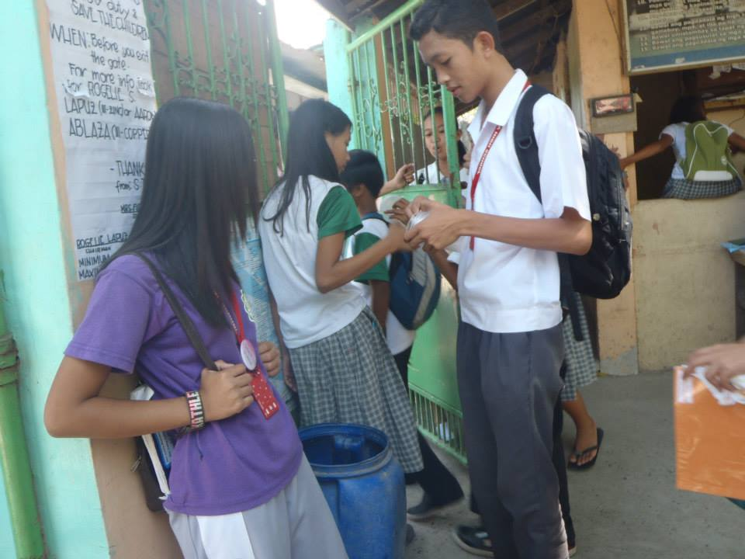

Slide 21
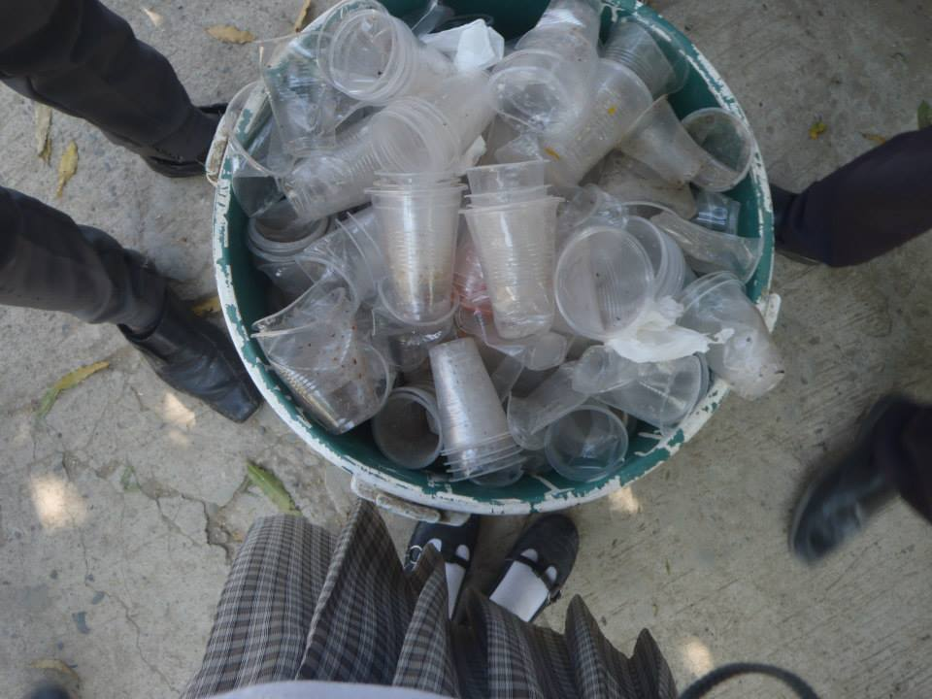

Slide 22
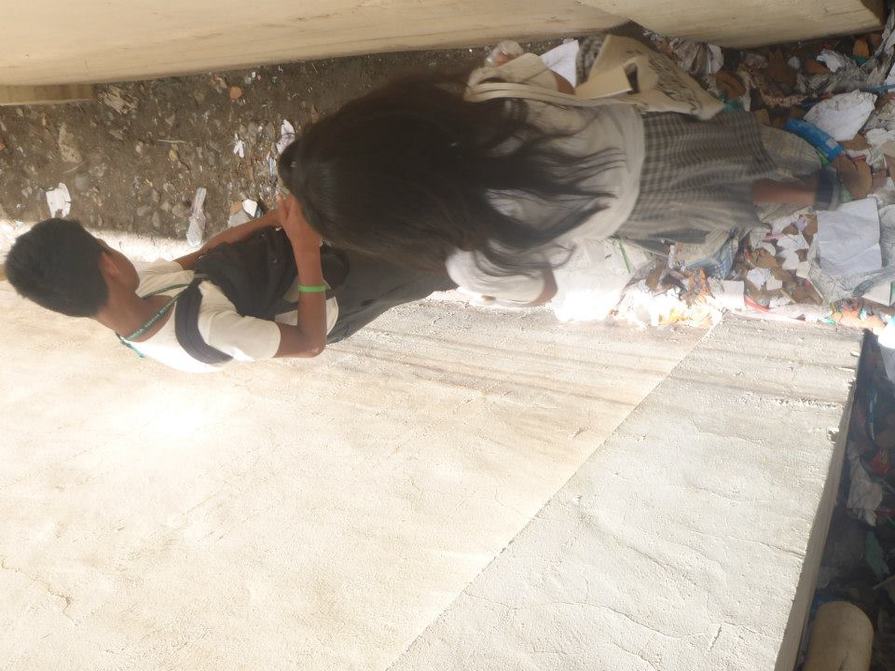

Slide 23
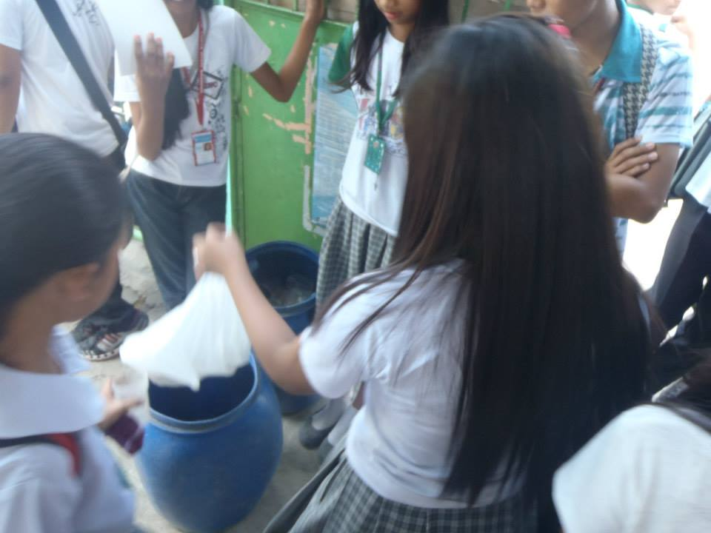

Slide 24
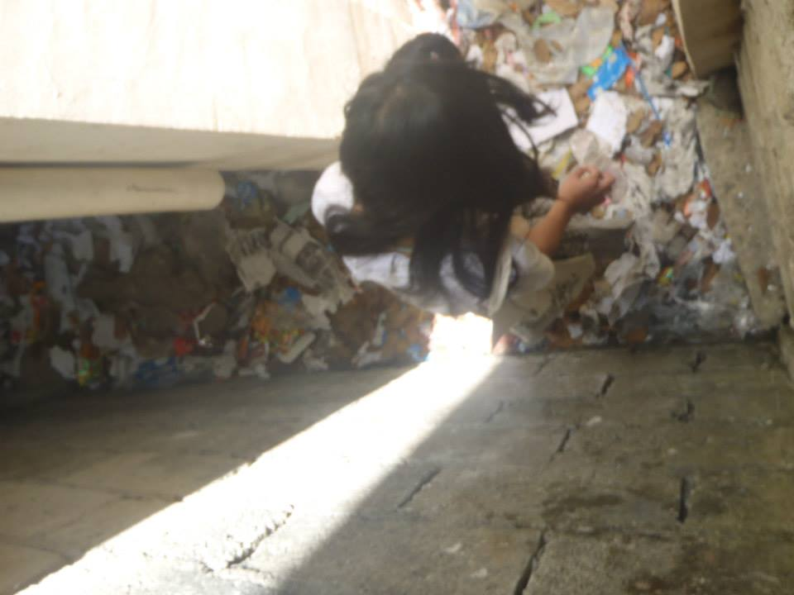

Slide 25
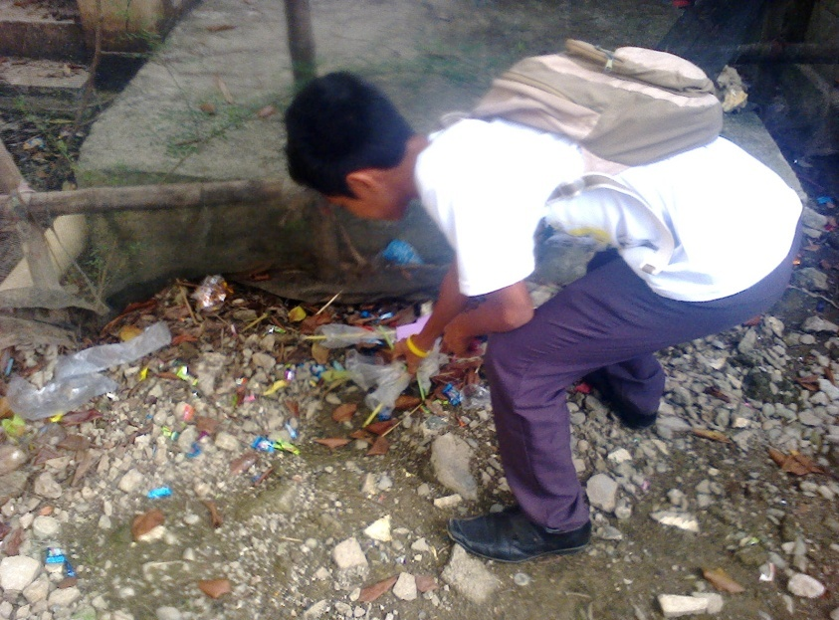

Slide 26
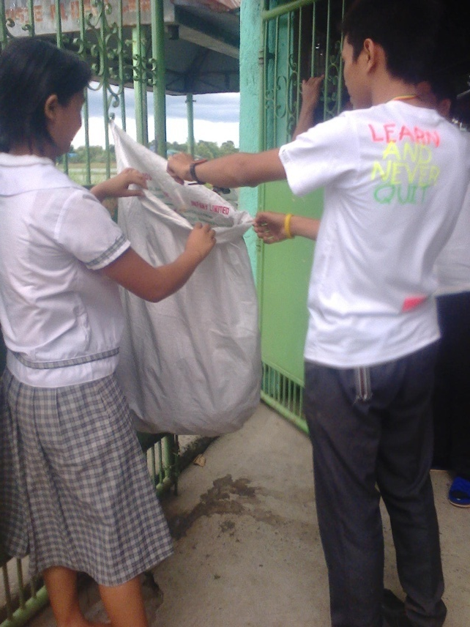

Slide 27
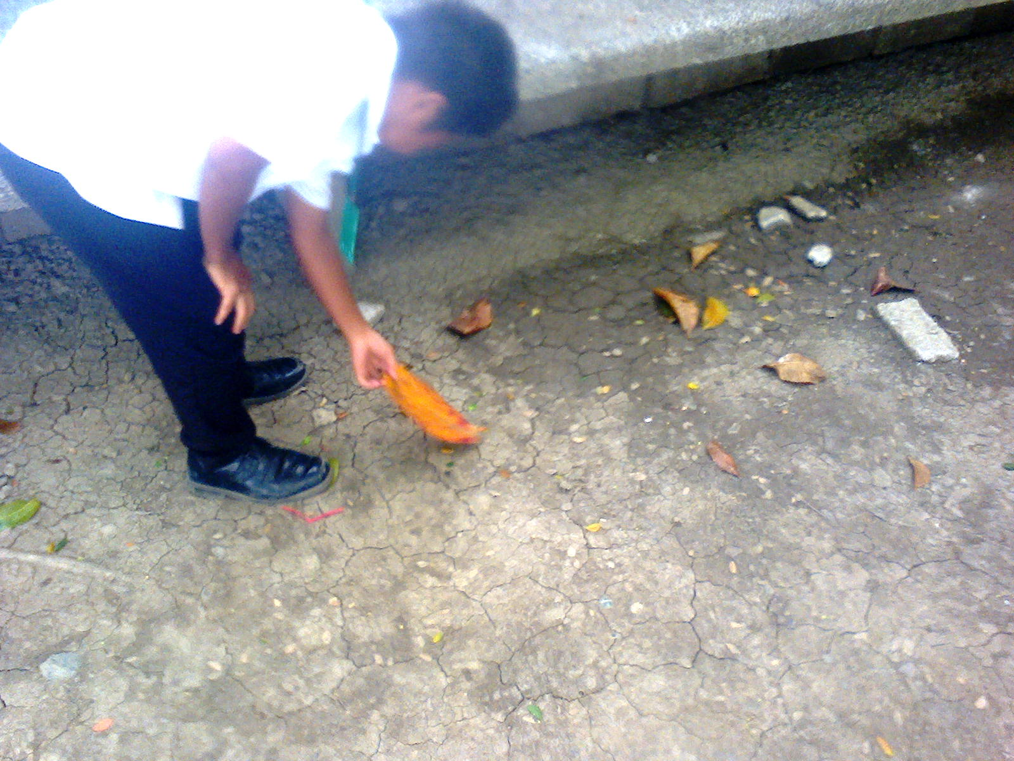

Slide 28
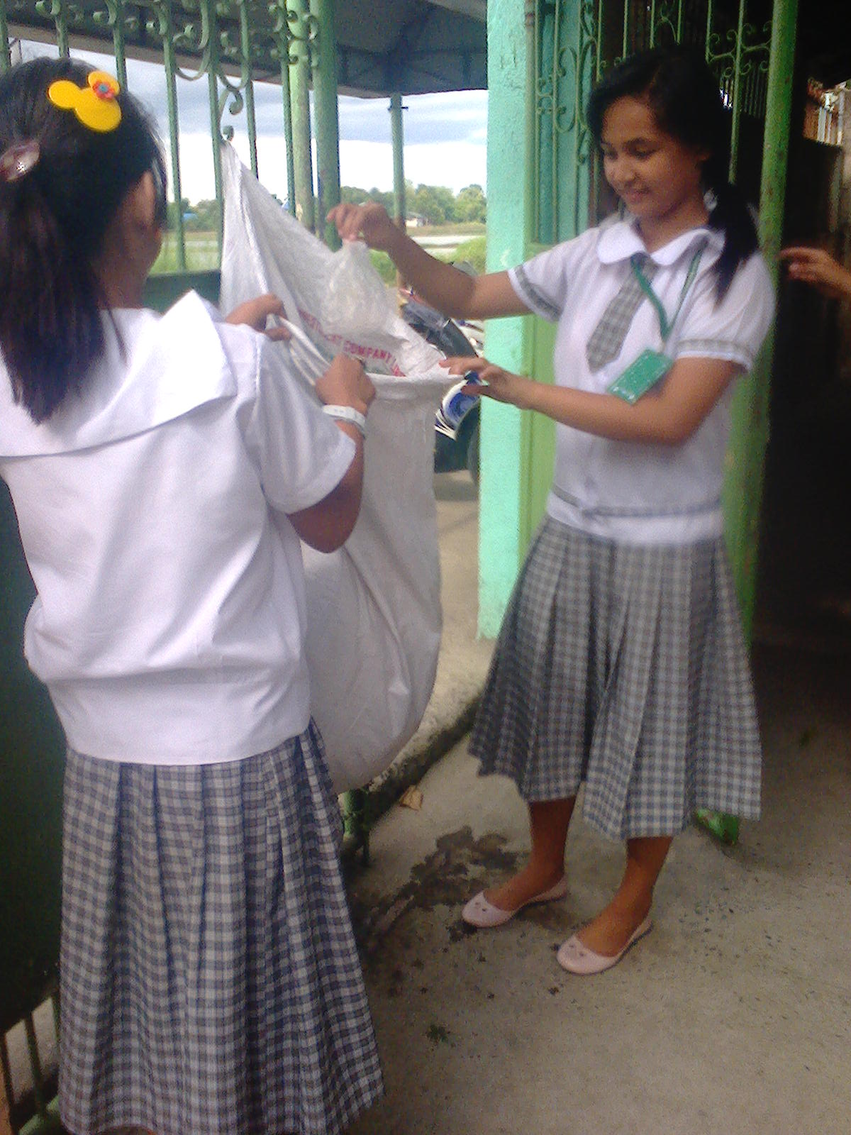

Slide 29
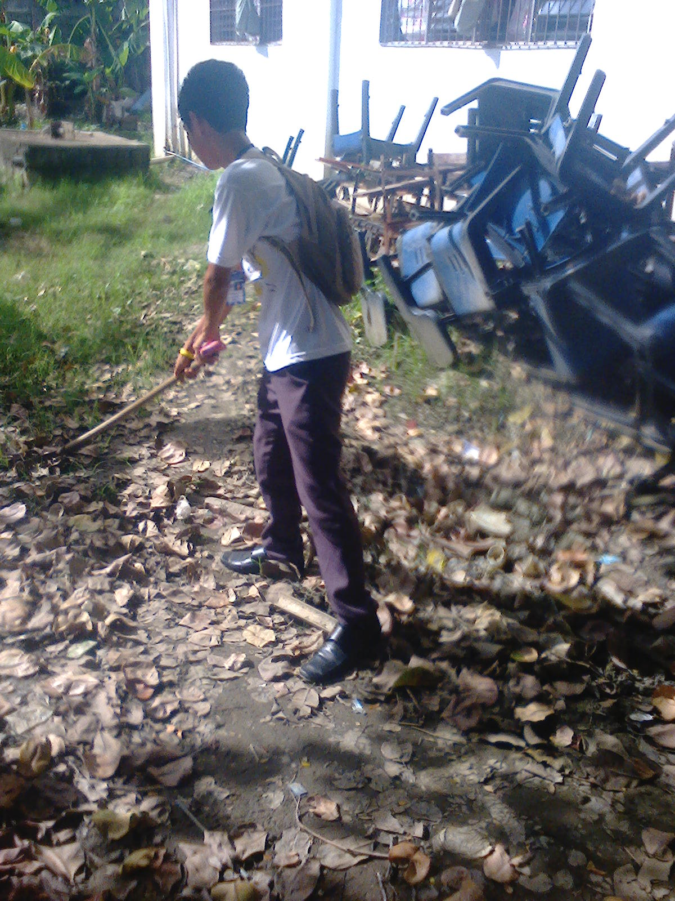

Slide 30
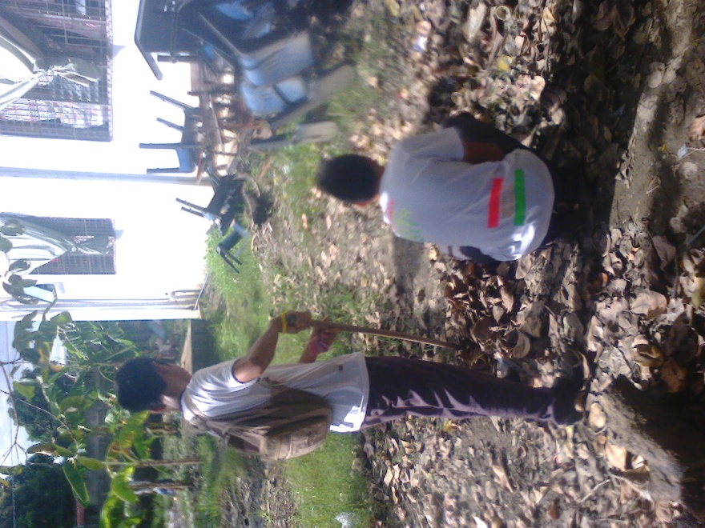

Slide 31
Thank You
For Watching
☺ ☺ ☺ ☺

