Slide 1
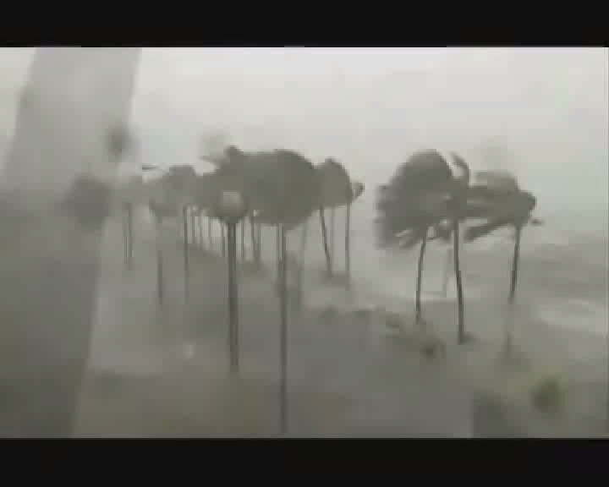

Slide 2
SJDMNHS SHINE Program
Accomplishment Report

Slide 3
OBJECTIVES
_______________

Slide 4
Enhance the disaster awareness of students through its regular hydrological monitoring and information campaign.

Slide 5
Encourage the proper management of our water resources in order to promote ecological balance and conservation.

Slide 6
Establish specific and doable programs, projects and activities to address issues and concerns on the environment especially in the hydrological aspects.

Slide 7
Network with other government and non-government organizations, in other schools or within the division, for support and assistance to programs, projects and activities of the club.

Slide 8
Develop a proper environmental values, skills, and attitudes among members and the community.

Slide 9
Programs,
Projects and
Activities

Slide 10
Election of Officers
KEY PERFORMANCE INDICATORS | TIME FRAME | REMARKS
Have leaders who will supervise the implementation of SHINE Programs and projects. | June, 2013 | Done

Slide 11
Monitoring and Posting of Rain Gauge Reading
PROGRAMS, PROJECTS AND ACTIVITIES | KEY PERFORMANCE INDICATORS | TIME FRAME
Performing and posting rain gauge reading | Check and monitor the amount of rainfall to increase awareness of students in terms of our weather | June, 2013- March, 2014

Slide 12
PROGRAMS, PROJECTS AND ACTIVITIES | KEY PERFORMANCE INDICATORS | TIME FRAME
“Jogging Para sa Malinis na barangay” Project | Heighten the willingness of the students in cleaning the surroundings especially water sewerages and esteros. | On going

Slide 13
PROGRAMS, PROJECTS AND ACTIVITIES | KEY PERFORMANCE INDICATORS | TIME FRAME
“Adopt-A-River” Project | Involve students in maintaining the cleanliness of our water forms | October, 2013

Slide 14
PROGRAMS, PROJECTS AND ACTIVITIES | KEY PERFORMANCE INDICATORS | TIME FRAME
Relief Operation | Collected goods for the typhoon victims and joined the CDRRM and other agencies in the repacking of relief goods. | As the need arises

Slide 15
Video of accomplished programs and projects

Slide 16
Rain Gauge Reading

Slide 17
Rain Gauge Reading

Slide 18
Rain Gauge Reading

Slide 19
Rain Gauge Reading

Slide 20
Rain Gauge Reading

Slide 21
Rain Gauge Reading

Slide 22
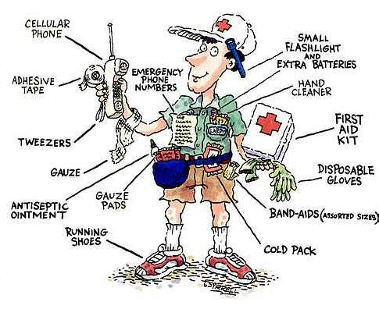
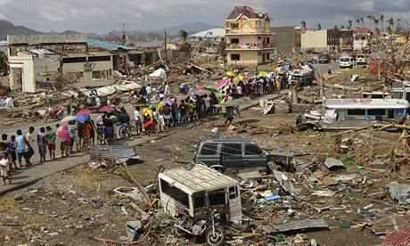
Future plans
Strengthen student involvement in awareness and preparedness on disasters brought by heavy rains.
Expansion of network and linkages that will support implementation of SHINE projects and programs

Slide 23
Be PREPARED…
Be AWARE…
Be READY…
SAVE LIFE, PROTECT OUR
PROPERTIES

Slide 24
GOD BLESS
PHILIPPINES…

