Slide 1
SHINe (School Hydrological Information Network) Presentation
Binagbag National High School
Binagbag, Angat Bulacan

Slide 2
CONTENTS:
BNHS’ SHINe Logo
BNHS’ Rainfall Data graph (January-November)
Climate Change Adaptation
Initiatives of SHINe
Reports of BNHS about SHINe
Plans of BNHS about SHINe

Slide 3
INTRODUCTION BNHS’ SHINe Logo

Slide 4
Rainfall Data Graph (January-November 2012)

Slide 5
Climate Change Adaptation
Climate change, the sudden change of weather or climate is already spread across the country.
The members of SHINe of BNHS have done a meeting about the climate change the school experiences. There are the evidences that we experience it:
1. When it’s noon, the weather is very hot. After some time, it rains.
What is the cause of this?

Slide 6
Climate change adaptation (causes of climate change in our environment)
a. The trees that absorb carbon dioxide were being cut.
b. There are so many garbages in our environment.
c .The garbages were being burned.
d. Farmlands are converted into commercial buildings, subdivisions, etc.
2. Even there’s sun it rains.
3. Even there’s a typhoon and we are affected, the whole day is sunny.
4. After hard rains, sun comes out and after a few minutes it rains again.
Why can’t we blame the nature? However, our school continuously creating ways to make a solution for this problem.

Slide 7
Some ways to prevent climate change
***3 B’s***
Be Aware
Be Alert
Be Prepared

Slide 8
INITIATIVES OF SHINe
Here are some initiatives of SHINe:
Cross visit
A good leader must be a good member.
The members should know their responsibilities and duties.
Knowing the significance of SHINe.
Daily visiting of the rain gauge.
Cooperation

Slide 9
Different reports of the school about shine
BNHS’ SHINe members made;
**Meetings**
**Orientation**
**Communication**
**Distribution**

Slide 10
Plans of BNHS about SHINe
INTERVIEW
COMMUNICATE
BULLETIN BOARDS
SHARING OF INFORMATIONS
DOOR TO DOOR
TEACHING

Slide 11
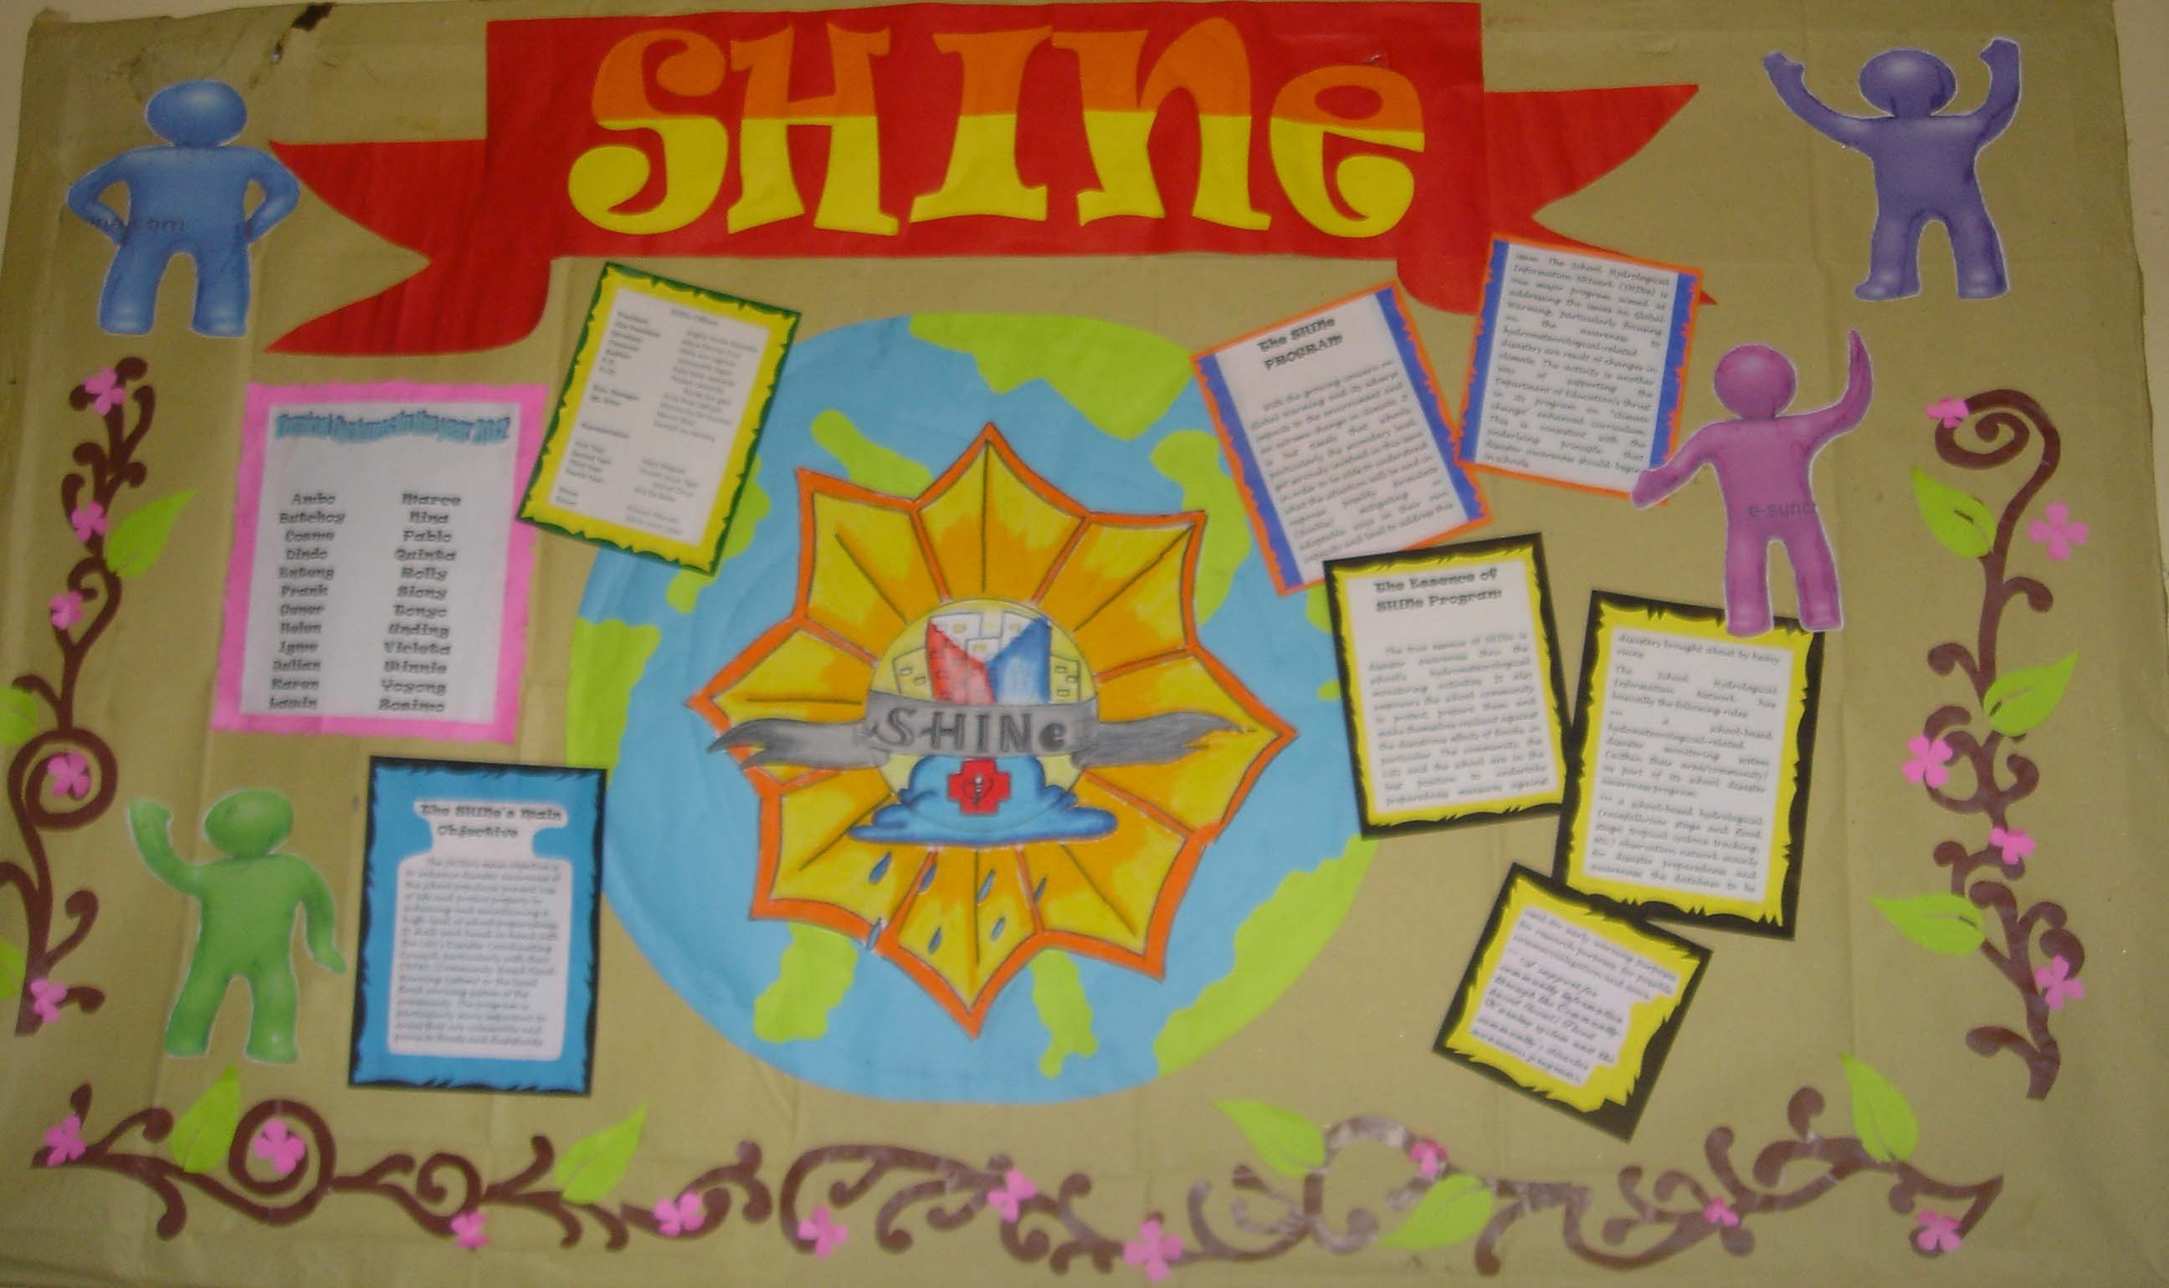
BNHS’ SHINE BULLETIN BOARD

Slide 12
END

Slide 13
THANK YOU!!!!!

