Slide 1
Norzagaray National High School

Slide 2
INTRODUCTION
NORZAGARAY NATIONAL HIGH SCHOOL
The establishment of Norzagaray Municipal High School was originally conceived by the former local officials of Norzagaray, Bulacan led by the then and former Hon. Municipal Mayor Eufemio T. Correa in June, 1968. The local government purchased the building and lot from Mr. and Ms. Celso L. Euterio of the neighboring town of Angat.
Norzagaray Municipal High School is established as a secondary school by virtue of section 2196. Norzagaray High School has been granted fiscal autonomy as per DepEd Regional Memorandum no. 83, s. 2004 dated August 1, 2004 and is hereby authorized to use its present name Norzagaray National High School (NNHS).

Slide 3
NNHS is located along Villarama Highway in Barangay Poblacion, Norzagaray, Bulacan. The main campus of of the school is situated in a 2,464 sq. m. site with concrete fences. Due to the growing student population NNHS has to expand its campus. NNHSAnnex I is located adjacent to the municipal compound and was constructed in 1997 under the incumbency of Mayor Feliciano Legaspi. As if the number of rooms was not enough NNHS has to request for additional classrooms, thus another building was built, the NNHS Annex II.

Slide 4
Head of the School
Lisa C. Cruz, Ed. D.
Principal III

Slide 6
Bulacan SHINe
Bulacan
S-chool
H-ydrological
I-nformation
Ne-twork

Slide 7
Advisers of Bulacan SHINe (Norzagaray Chapter)
Mr. Martin S. Santos
Mr. Reynaldo F. Paed

Slide 8
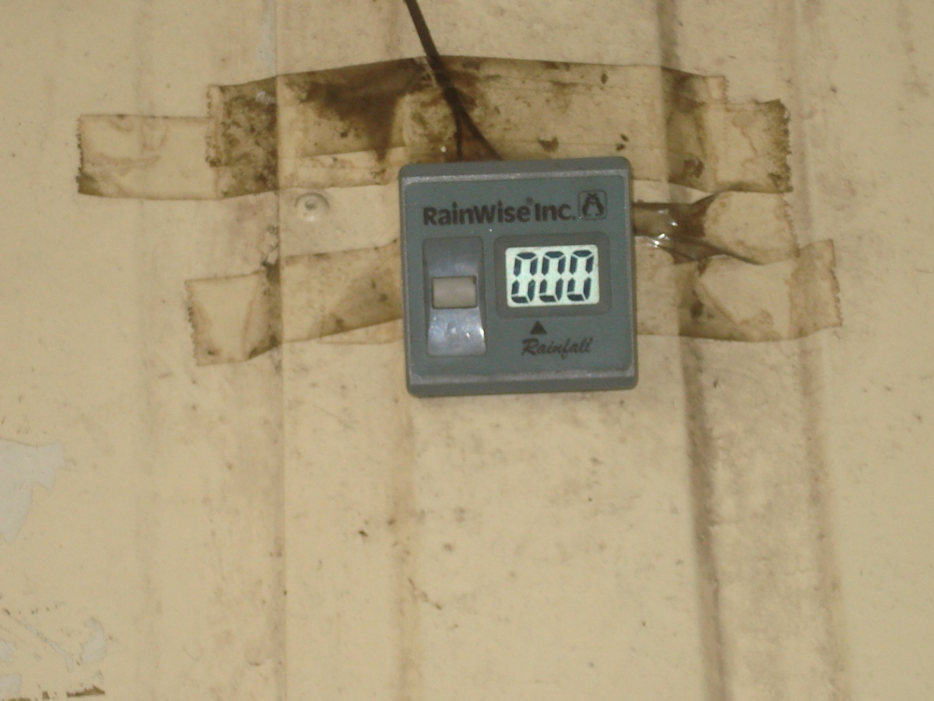
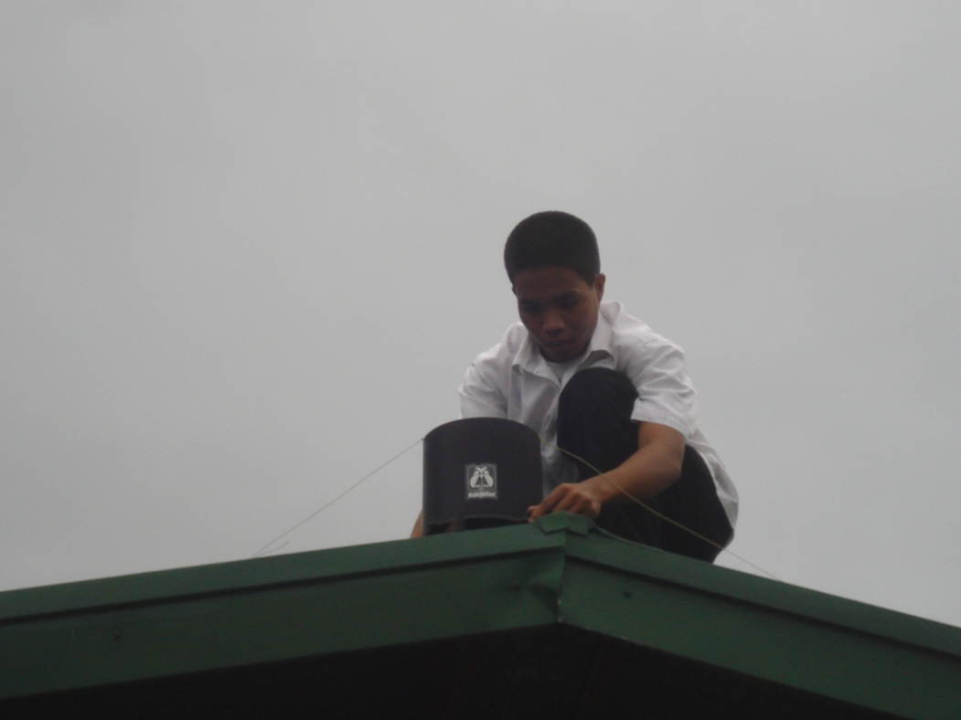
Rain Gauge

Slide 9
Bulacan SHINe Officers (Norzagaray Chapter)

Slide 10
President : Ezra C. Cruz
Vice Pres. : Janine C. Crisostomo
Secretaries : Jessica Stephanie P. Sarmiento
Alyssa Marice E. Palad
Treasurers : Kristopher P. Ong
Auditor: Sharmaine B. Rutaquio
P.I.O : Johanna Marie Fe Cruz
Peace Officers: Dan A. Sarito
Escort: Albert L. Esquivel
Muse: Evita Mae Bau

Slide 11
Data Presentations Type of Gauge: Digital RR

Slide 12
Achievements or Accomplishments

Slide 13
Bulacan SHINe awareness among the students through :

Slide 14
1.1 Integration to the lesson specially to MAPEH and Science subjects. 1.2 Meetings and symposium (target levels: Grade 7 through Fourth year)

Slide 15
1.3 Linking to other clubs in the school regarding cleanliness.

Slide 16
BENEFITS GAINED
1. Every student becomes aware of the surroundings.
2. The student develops personal accountability especially in terms of garbage disposal.
3. To plant trees turns into a mission in order to save mother nature.
4. Planting and eating vegetables becomes a healthy habit.
5. Awareness becomes contagious and everyone becomes vigilant, health conscious and environment-friendly.

Slide 17
For our Plans: 1. in school 2. in barangay

Slide 18
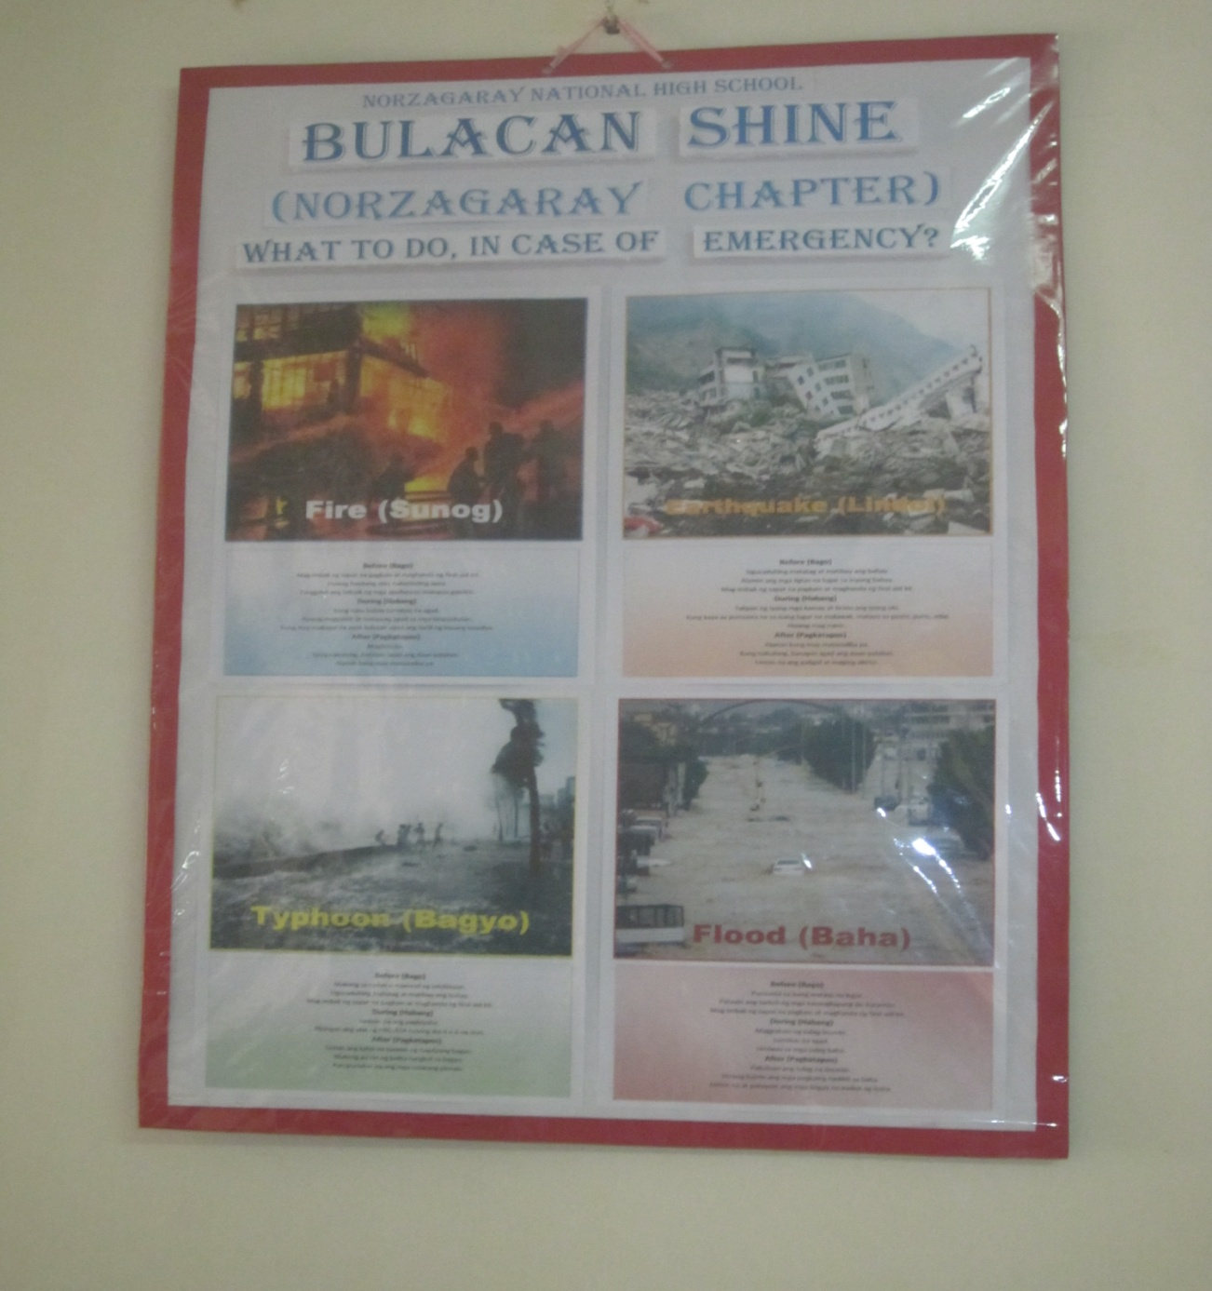

Slide 19
What to do, in case of emergency?

Slide 20
Fire (sunog)

Slide 21
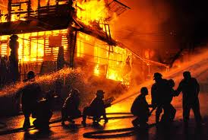
Before:
During:
After:
Tanggalin ang saksak ng mga appliances matapos gamitin.
Kung nasa bahay lumabas na agad.
Maglinis na.
Mag-imbak ng sapat na pagkain at maghanda ng first aid kit.
Huwag magpanik at tumawag agad sa mga kinauukulan.
Kung nakulong, hanapin agad ang daan palabas.
Huwag hayaang may nakasinding apoy.
Kung may makapal na usok balutan agad ang sarili ng basang tuwalya.
Alamin kung may maisasalba pa.

Slide 22
Earthquake (lindol)

Slide 23
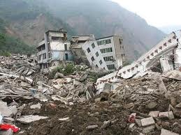
Before:
During:
After:
Mag-imbak ng sapat na pagkain at maghanda ng first aid kit.
Kung kaya ay pumunta na sa isang lugar na malawak malayo sa poste, puno atbp.
Alamin kung may maisasalba pa.
Siguraduhing matatag at matibay ang bahay.
Huwag mag panic.
Kung nakulong, hanapin agad ang daan palabas.
Alamin na ang ligtas na lugar sa iyong bahay..
Takpan ng iyong kamay at braso ang iyong ulo.
Linisin na ang paligid at maging alerto.

Slide 24
Flood (baha)

Slide 25
Before:
During:
After:
Mag-imbak ng sapat na pagkain at maghanda ng first aid kit.
Magpakulo ng tubig-inumin.
Pakuluan ang tubig na iinumin.
Pumunta sa isang mataas na lugar.
Umiwas sa mga tubig baha.
Huwag kainin ang mga pagkaing nadikit sa baha.
Patayin ang switch ng mga kasangkapang de-kuryente.
Lumikas na agad.
Linisin na at patuyuin ang mga bagay na inabot ng baha.

Slide 26
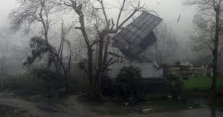
Typhoon (bagyo)

Slide 27
Before:
During:
After:
Mag-imbak ng sapat na pagkain at maghanda ng first aid kit.
Iwasan na ang pagbiyahe.
Makinig pa rin ng balita tungkol sa bagyo.
Making sa radyo o telebisyon.
Abangan ang ulat ng PAG-ASA tuwing ika 4 o 6 na oras.
Linisin ang kalat na naiwan ng nagdaang bagyo.
Siguraduhing matatag at matibay ang bahay.
Kumpunuhin na ang mga naiwang pinsala.

Slide 28
Here in SHINe Norzagaray Chapter, we aim to be of service to our community and become responsible and productive citizens of our country.

